Slide 1
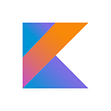
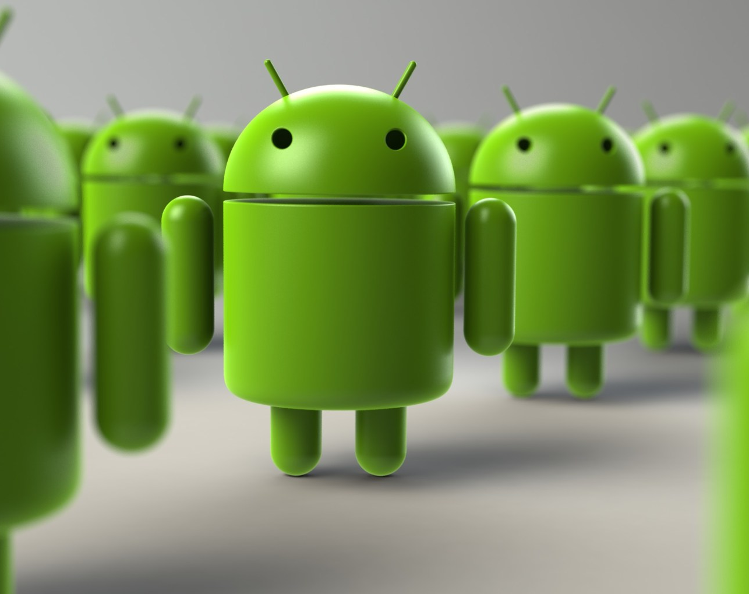
Introduction to Kotlin and Android Development
This Photo by Unknown Author is licensed under CC BY-NC

Slide 2
What is Kotlin ?
A modern, easy to use programming language.
Developed by JetBrains.
Fully interoperable with Java.
Official language for Android development (since 2017).

Slide 3
Features of Kotlin
Null Safety
Extension Functions
Smart Casts
Data Classes
Coroutines
Lambda Expressions

Slide 4
Why Kotlin for Android?
Concise and expressive syntax.
Interoperability with existing Java code.
Coroutines for asynchronous programming.
Features like Scope functions, Higher Order functions etc.
Backed by Google and JetBrains.

Slide 5
What is Android ?
Android is an open-source mobile OS developed by Google.
World’s most widely used OS.
Used in smartphones, tablets, TVs, and wearables.
Android apps are primarily developed using Kotlin or Java.

Slide 6
Key Android Components
Activities – UI screens
Fragments – Modular sections of UI
Services – Background tasks
Broadcast Receivers – Respond to system-wide events
Content Providers – Manage app data

Slide 7
THANK YOU
Team- Android Development With Kotlin
Presented by- Sunil Kumawat, Tejaswini Girase

